Slide 1

<Name>
<Date>

Slide 2

Outline
Executive Summary
Introduction
Methodology
Results
Conclusion
Appendix

Slide 3
Executive Summary
Summary of methodologies
Data Collection
Data Wrangling
EDA with Data Visualization
Building an interactive map with Folium
Building a Dashboard with Plotly Dash
Predictive Analysis (Classification)
Summary of all results
EDA Result
Interactive Analytics
Predictive Analysis

Slide 4
Introduction
Project background and context
SpaceX advertises Falcon rocket launches on it’s website, with a cost of 62 Million dollars; other providers cost upward of 165 Million dollars, each much of the savings is because SpaceX can reuse the first stage.
Problems you want to find answers
The project task is to predicting if the 1st stage of the SpaceX Falcon rocket will land successfully.

Slide 5

Section 1

Slide 6
Methodology
Executive Summary
Data collection methodology:
SpaceX Rest API
Perform data wrangling
One Hot Encoding data fields for machine learning and Data Cleaning of null values and irrelevant columns.
Perform exploratory data analysis (EDA) using visualization and SQL
Perform interactive visual analytics using Folium and Plotly Dash
Perform predictive analysis using classification models
LR, KNN, SVM, DT model have been built and evaluated for the best Classifier.

Slide 7
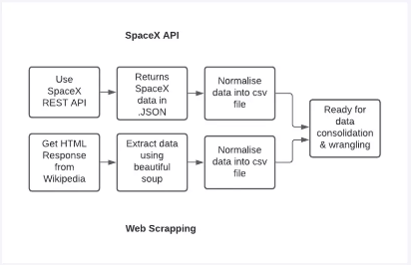
Data Collection
The following dataset was collected:
SpaceX launch data that is gathered from the SpaceX REST API.
This API will give us data about launches, including information about the rocket used, payload delivered, launch specification, landing specifications and landing outcome.
The SpaceX REST API endpoints, or URL, starts with api.spacexdata.com/v4/.
Another popular data source for obtaining Falcon 9 Launch data is web scrapping Wikipedia using BeautifulSoup.

Slide 8
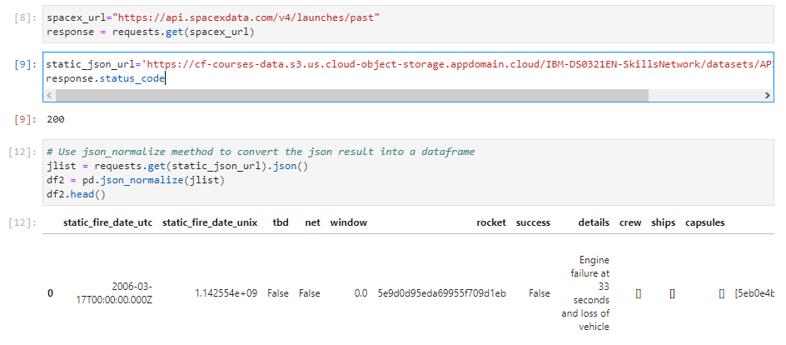
Data Collection – SpaceX API
Data collection with SpaceX Rest calls

Slide 9
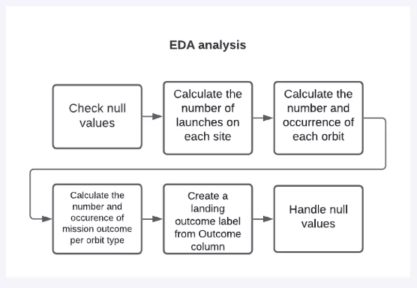
Data Wrangling

Slide 10
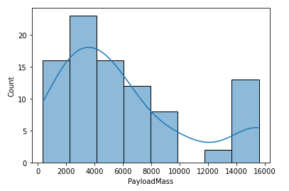
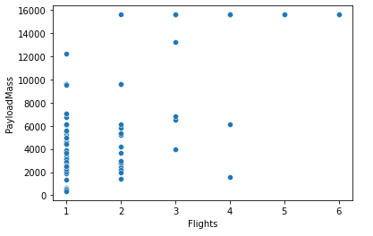
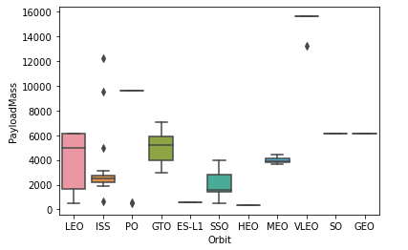
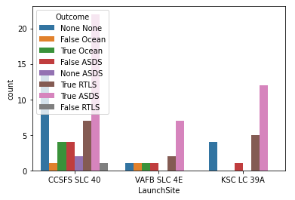
EDA with Data Visualization

Slide 11
EDA with SQL
SQL queries performed include:
Displaying the names of the unique launch sites in the space mission
Displaying 5 records where launch sites begin with the string 'KSC'
Displaying the total payload mass carried by boosters launched by NASA (CRS)
Displaying average payload mass carried by booster version F9 v1.1
Listing the date where the successful landing outcome in drone ship was achieved.
Listing the names of the boosters which have success in ground pad and have payload mass greater than 4000 but less than 6000
Listing the total number of successful and failure mission outcomes
Listing the names of the booster versions which have carried the maximum payload mass.
Listing the records which will display the month names, successful landing outcomes in ground pad, booster
versions, launch site for the months in year 2017
Ranking the count of successful landing outcomes between the date 2010 06 04 and 2017 03 20 in descending order.

Slide 12
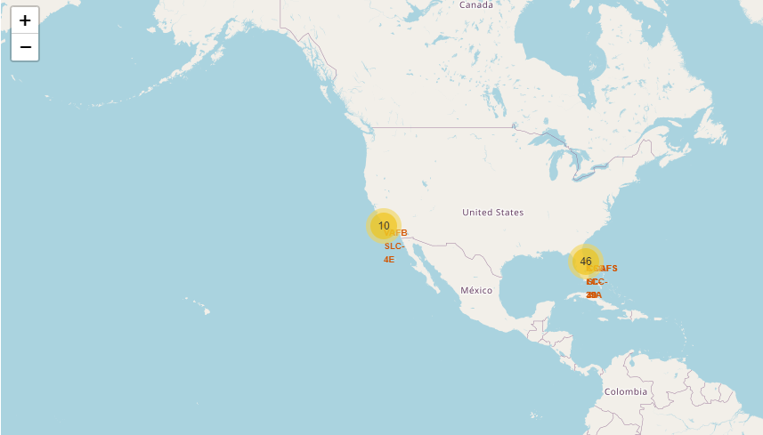
Build an Interactive Map with Folium

Slide 13
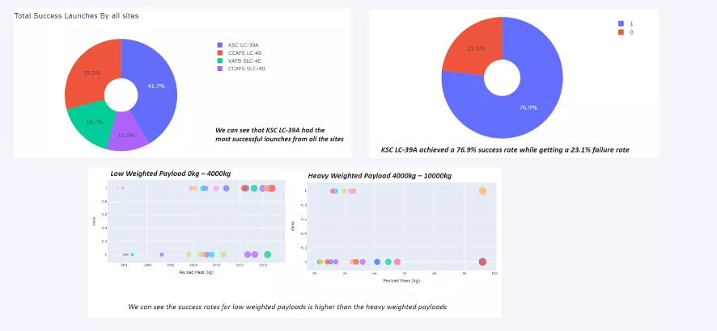
Build a Dashboard with Plotly Dash

Slide 14
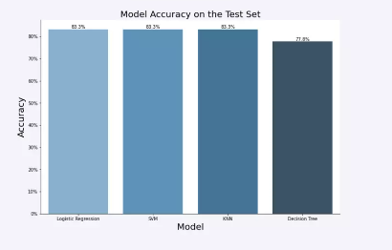
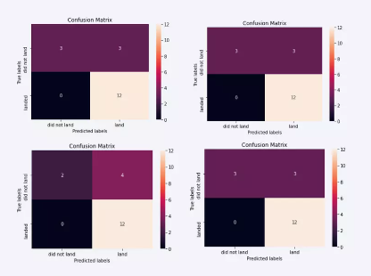
Predictive Analysis (Classification)
The SVM, KNN, and Logistic Regression model achieved the highest accuracy at 83.3%, while the SVM performs the best in terms of Area Under the Curve at 0.958.

Slide 15
Results
The SVM, KNN, and Logistic Regression models are the best in terms of
prediction accuracy for this dataset.
Low weighted payloads perform better than the heavier payloads.
The success rates for SpaceX launches is directly proportional time in years they
will eventually perfect the launches.
KSC LC 39A had the most successful launches from all the sites.
Orbit GEO,HEO,SSO,ES L1 has the best Success Rate.

Slide 16

Section 2

Slide 17
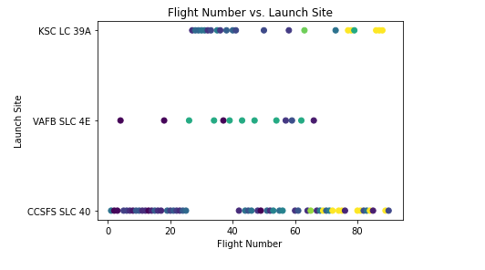
Flight Number vs. Launch Site

Slide 18
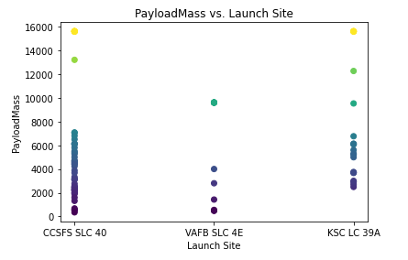
Payload vs. Launch Site

Slide 19
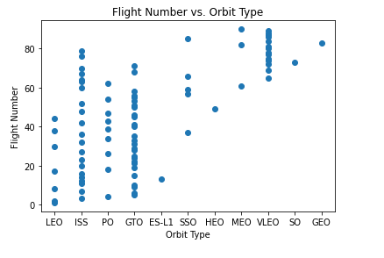
Flight Number vs. Orbit Type

Slide 20
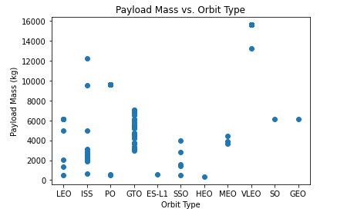
Payload vs. Orbit Type

Slide 21
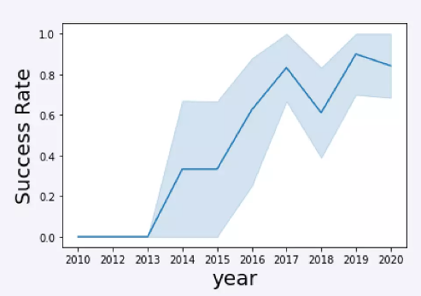
Launch Success Yearly Trend

Slide 22
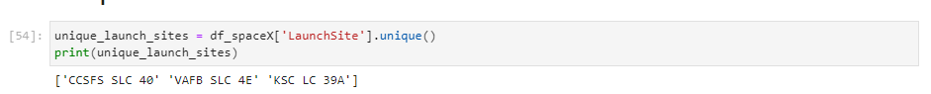
All Launch Site Names
%sql select distinct (LaunchSite) from spaceX

Slide 23
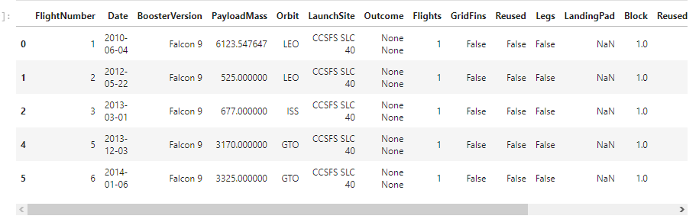
Launch Site Names Begin with 'CC'
%sql select * from spaceX where LaunchSite ‘CC%’ limit 5

Slide 24

Total Payload Mass
%sql select sum(PayloadMass) from spaceX where customer = ‘NASA’

Slide 25
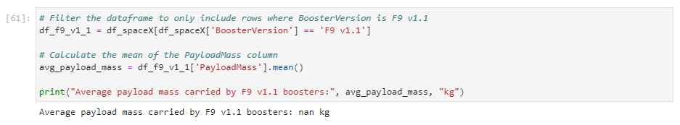
Average Payload Mass by F9 v1.1
%sql select avg(PayloadMass) from spaceX where BOOSTER_VERSION=‘F9 v1.1’

Slide 26
First Successful Ground Landing Date
%sql select min(DATE) from spaceX where Landing_outcome = ‘Success(ground pad)’

Slide 27
Successful Drone Ship Landing with Payload between 4000 and 6000
%sql select BOOSTER_VERSION from spaceX where Landing_Outcome = ‘Success(drone ship)’ and PayloadMass>4000 and PayloadMass < 6000

Slide 28
Total Number of Successful and Failure Mission Outcomes
%sql select count(MISSION_OUTCOME) from spaceX where MISSION_Outcome = ‘Success’ or MISSION_Outcome = ‘Failure (in flight)’

Slide 29
Boosters Carried Maximum Payload
%sql select BOOSTER_VERSION from spaceX where PayloadMass =(select max(PayloadMass) from spaceX)

Slide 30
2015 Launch Records
%sql select * from spaceX where Landing_Outcome like ‘Success%’ and (DATE between ‘2015-01-01’ and ‘2015-12-31’) order by date desc

Slide 31
Rank Landing Outcomes Between 2010-06-04 and 2017-03-20
%sql select * from spaceX where Landing_Outcome like ‘Success%’ and (DATE between ‘2010-06-04’ and ‘2017-03-20’) order by date desc

Slide 32

Section 3

Slide 33
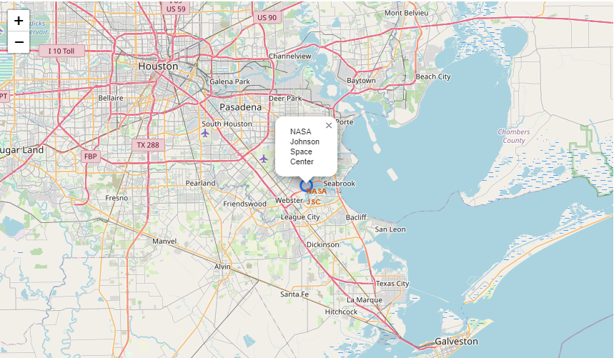
All launch sites marked on a map

Slide 34
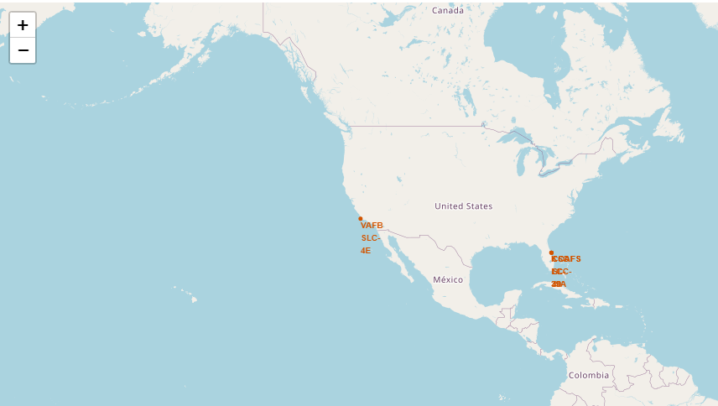
Success / failed launches marked on the map

Slide 35
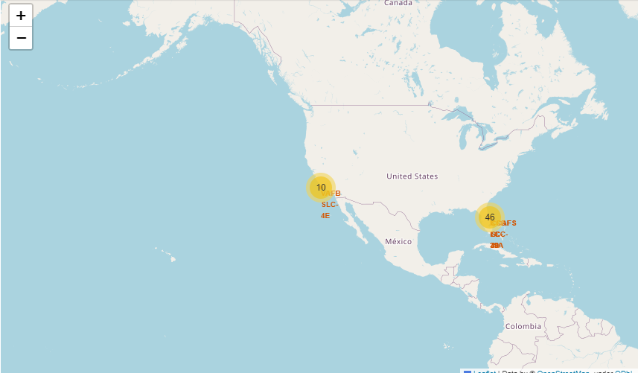
Distance between a launch site to its proximities

Slide 36

Section 4

Slide 37

Total Success Launch by all sites

Slide 38
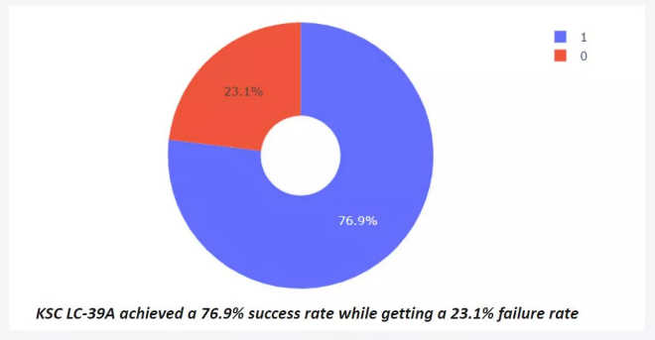
Success Rate by site

Slide 39
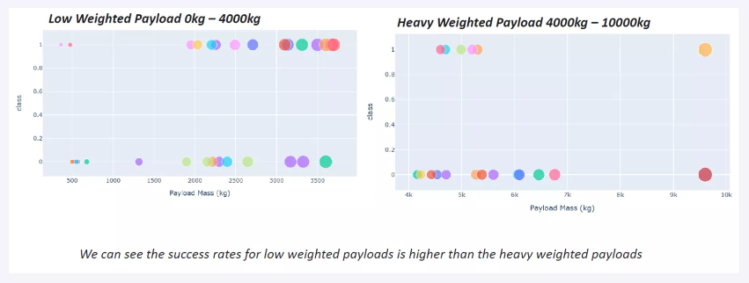
Payload vs Launch Outcome

Slide 40

Section 5

Slide 41
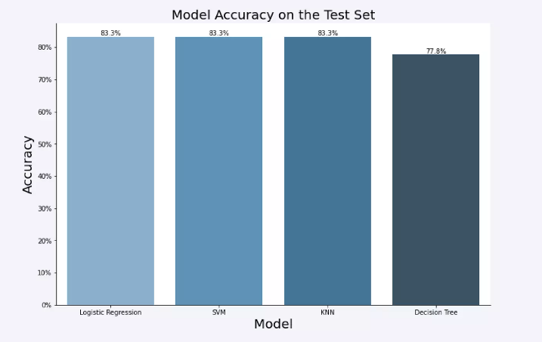
Classification Accuracy

Slide 42
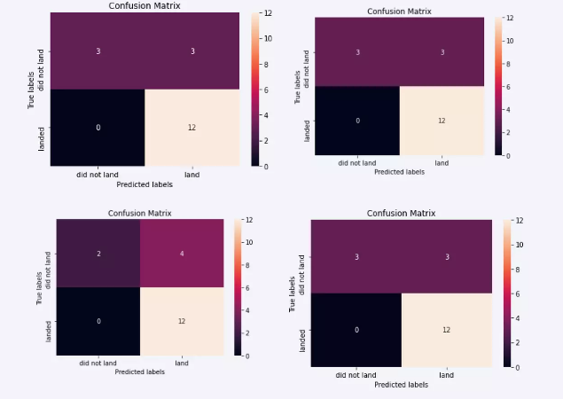
Confusion Matrix

Slide 43
Conclusions
The SVM, KNN, and Logistic Regression models are the best in terms of prediction accuracy for this dataset.
Low weighted payloads perform better than the heavier payloads.
The success rates for SpaceX launches is directly proportional time in years they will eventually perfect the launches.
KSC LC 39A had the most successful launches from all the sites.
Orbit GEO,HEO,SSO,ES L1 has the best Success Rate.

Slide 44


